Slide 1
SAI GOKULA SEVA SAMSTHE®

Slide 2
About Us
Sai Gokula Seva Samsthe ®, is a NGO . It was set up in the year 2004 , by our beloved Chairman /Founder, Shri. A. M. Rajendra Prasad. It was his dream of rendering services to the society for the upliftment and betterment of the urban part of community.
To do any job , first we need to gain good knowledge and experience so that we can be the better and progress. So , our Chairman /Founder rendered his 20 years of service in Shathashrungha Ashram, Kengeri.
Everyday was a learning experience as the days were passing by. Years passed on and today here we stand as one of the best NGO who is serving the needy .

Slide 3
About our Chairman & Founder
Our Founder & Chairman
Shri. A M. Rajendra Prasad-
He was born in the year 1972, in a village . He was bought up well and he completed his schooling in T. Agrahara. Later, for the further studies he had to move to his uncle’s home at K R PURAM.
He completed his degree in Bachelor of Arts . He also did his ITI in Mechanical studies
He rendered his services , in Shathasrungha Aashram, under the supervision and guidance of his Excellency Sri. Ram Prasad Guruji.

Slide 4
Glimpse of our Chairman & Founder in our Victory Path

Slide 5
Registered office…
Sai Gokula Seva Samsthe(R) (SGSS)
Sri Ranga Building, 5th cross, T G Extension, Hoskote Town- 562114, Bangalore Rural Dist. Karnataka, India
Ph: +91 9945329169/ 7625041380.
E Mail ID: saigokulasevasamsthe@gmail.com
saigss2005@gmail.com
Website: www.sgsstrust.org
Registered under Trust Registration Act Reg. No. KRI-4-00504-2005-06-00191-17-18.

Slide 6
Our Mission
Sai gokula stands for Committed to provide a way for better society by supporting the poorest rural and urban through being the preferred social service provider, contributing to the social & environmental prosperity of Karnataka.

Slide 7
Our Vision
Sai gokula is decided to the holistic development of the under privileged and marginalized of our society through the expansion of proper utilization of their capabilities. It is facilitating sustainable initiative in the target community, empowering women and child and promoting education and health.

Slide 8
Our Motto
Our motto is each and every individual is able to do learn what he can if given an opportunity.
We shall try to give opportunities to the most remote rural community who are underprivileged.
Women, underprivileged, youth and children are the people who we think equal learning opportunities should be given to.

Slide 9
Bank Details
Trust Account
Bank Name: State Bank Of India,
SME Branch Hoskote, Bangalore Rural (D) - 562114
IFSC Code: SBIN0011293
Account number: 37117428205
MICR Code: 560002138.
FCRA Account
Bank Name: State Bank Of India
ADB Branch Hoskote, Bangalore Rural (D) - 562114
IFSC Code: SBIN0001808
Account number: 10699464611
MICR Code: 560002088

Slide 10
Office Information Cell
Sai Gokula Seva Samsthe(R)
PAN: AAGTS8342D
TAN Number: BLRS55529F
12A : Registration Number – DIT(E)BLR/12A/S-1929/AAGTS8342D/ITO(E)-3/Vol 2007-2008.
Certificate under section 12A R/w Section 12AA(1)(b)(i) of the Income Tax Act, 1961.
80G : Registration Number – DIT(E)BLR/80G(R)/100/AAGTS8342D/ITO(E)-3/Vol 2009-2010.
Approval under Section 80G(5)(vi) of the Income Tax Act, 1961.
80G : Registration Number – DIT(E/80G(R/48/AADTS8342D/ITO(E)-3/2011-12.
FCRA: Registration Number - 094370008. Under economic, education, social regd. under
Ministry of home affairs, Foreigners division.
GuideStar Number (GSN) : 10277
Darpan (NITI Aayog, Government of India) ID : KA/2009/0010703

Slide 11
Women Empowerment & Child Care
Our first and foremost step taken after inauguration of our NGO was to bring out the hidden talents of Women, because we believed in –
“If a man is educated only an individual is educated , but if a women is educated the whole family is educated”.
We could provide training for women in the rural areas in the local language so that they can know how to read and write in the local language.
Tailoring and Beautician courses were also conducted so that the women can make a provision for their regular income.
After conducting such workshops we studied that there are requirement of such workshops in the rural areas .
We also had some workshops for the children of the labours working under Construction sites etc.
It was a great opportunity for Sai Gokula Seva Samsthe to render our services to the needful in full fledge and most appreciable was we were also being appreciated by the beneficiaries.

Slide 12
Providing Stationary supplies to the needy
It was a glorious moment for us when we were celebrating our fifth Anniversary.
We distributed stationary to the underprivileged children studying in Government Schools in and around Hoskote.
It was then we had a thought of starting an Old Age Home .
The idea was executed in very quick note , as we immediately started up with the setups of old age home ,in the same year.
After a couple of years we started a school for Deaf and Dumb children.
We had a privileged of serving these children.
We even had 10 children who passed out their 10th Grade in excellence.
These were only a few achievements to pen down of Sai Gokula Seva Samsthe.

Slide 13
Our Achievements in the Digital World
We had a partnership with NASSCOM FOUNDATIONS.
We in association with Erricson and in a partnership with NASSCOM started a NDLM CENTRE at Hoskote.
The NDLM SCHEME is National Digital Literacy Mission, through which we trained the beneficiaries between the age group of 16 to 60 years old.
We had an opportunity to educate the needy through this scheme.
Through this scheme we trained around 1000 and more beneficiaries.
It was appreciated by NASSCOM AND ERICSSON too.
This added a feather to Sai Gokula Seva Samsthe’s cap.

Slide 14
Now, We had a tie up with INFOSYS and NASSCOM for the NDLM SCHEME- We have successfully trained around 3000+ beneficiaries and still tend to exceed .
There were beneficiaries in all age groups especially Women and Youth were in huge numbers.
We in association with NASSCOM ,along with leading IT COMPANIES such as INFOSYS, ATOS ,CGI are successfully running the program . Looking forward to convert whole of remote areas to Digitalizing.
Moving ahead we also include many current relevant requirements such as Internet , Mobile Wallet, Social Media etc to the middle aged beneficiaries who have the willingness to learn and keep themselves updated.

Slide 15
Our hands towards women Empowerment
We believe in women, as the saying goes – If a man is educated only he is educated. But, if a women is educated the complete family is educated. So, we stretched our hands towards the development of women education. We introduced short term workshops and skill development courses.
The workshops were –
Beautician Course
Tailoring Course
Soft toys & Embroidery course.
We started these workshops with the intention of educating women through skills so that she can earn and she can be financially stable.
Large number of women participated in this workshop. Most of them were from remote villages in and around Hoskote and Bidrahalli.

Slide 16
Our Future Endeavors
To introduce Computer literacy in the rural Government Schools . Where in there are limited resources and unlimited requirements.
We have plans to educate Women and men in updating the usage of plastic money thoroughly. Such as what are Debit and Credit cards , what are their benefits and drawbacks. How can one be aware of frauds .
Short term courses for school going children and college going students .
Beautician course and Skill Development course for house wives such as Jewellery making, Tailoring and Soft toy making etc through which they can improve their financial status.

Slide 17
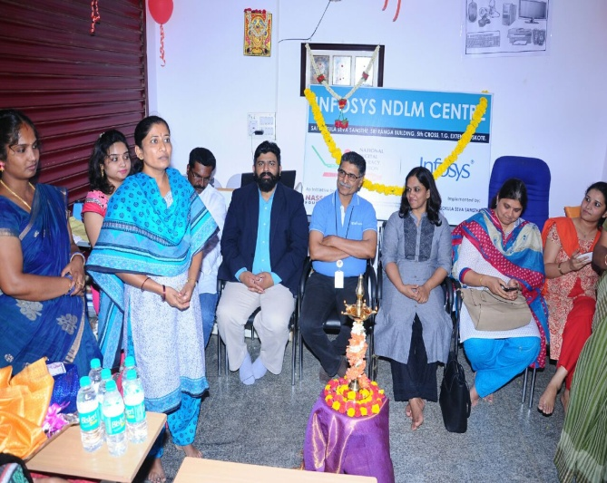
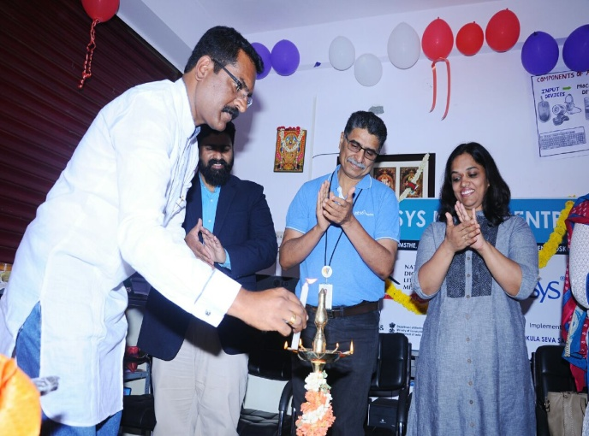
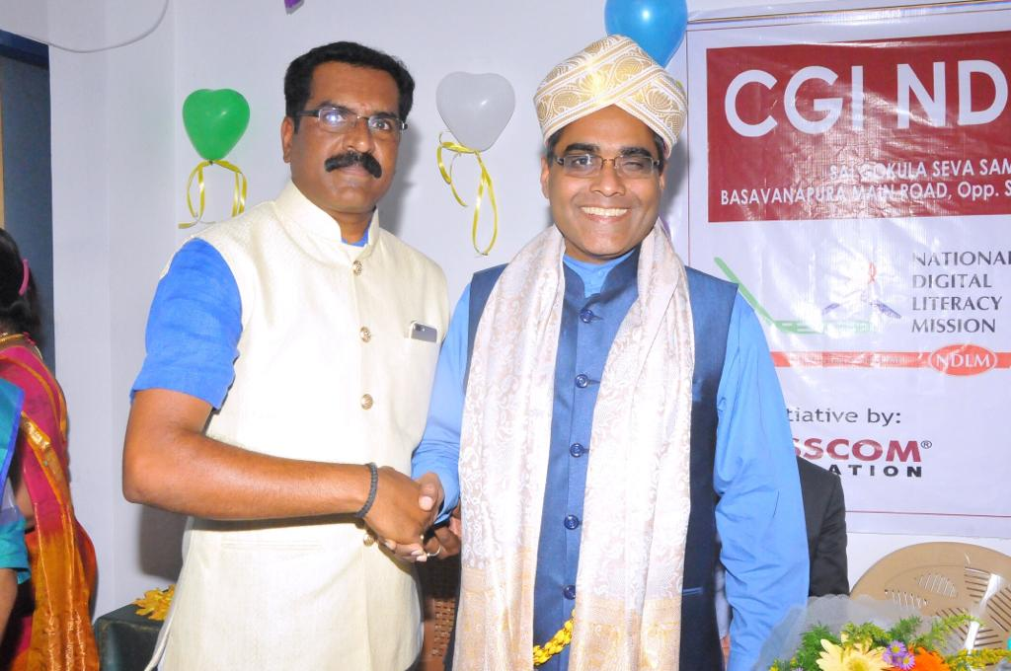
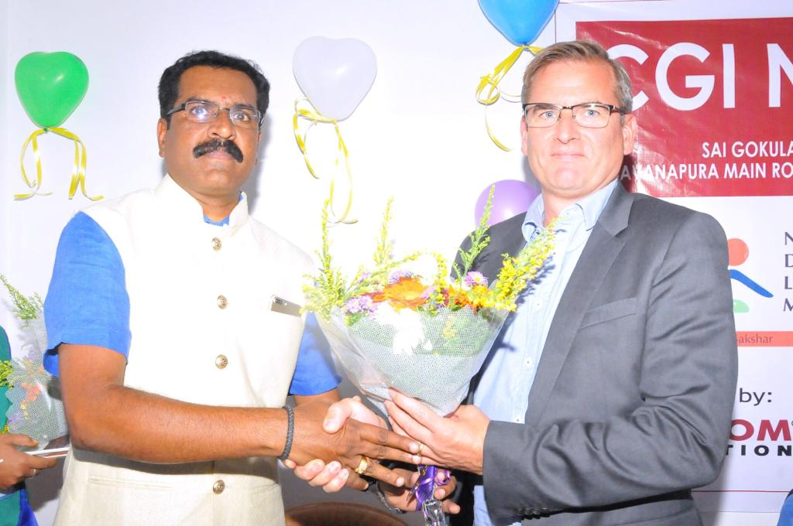
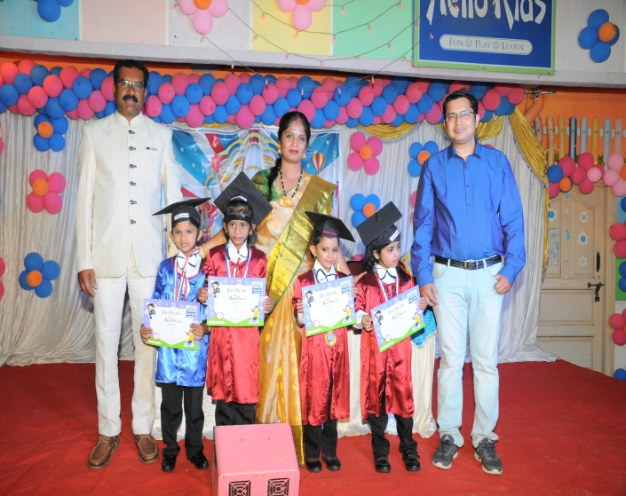
Our Galary

Slide 18
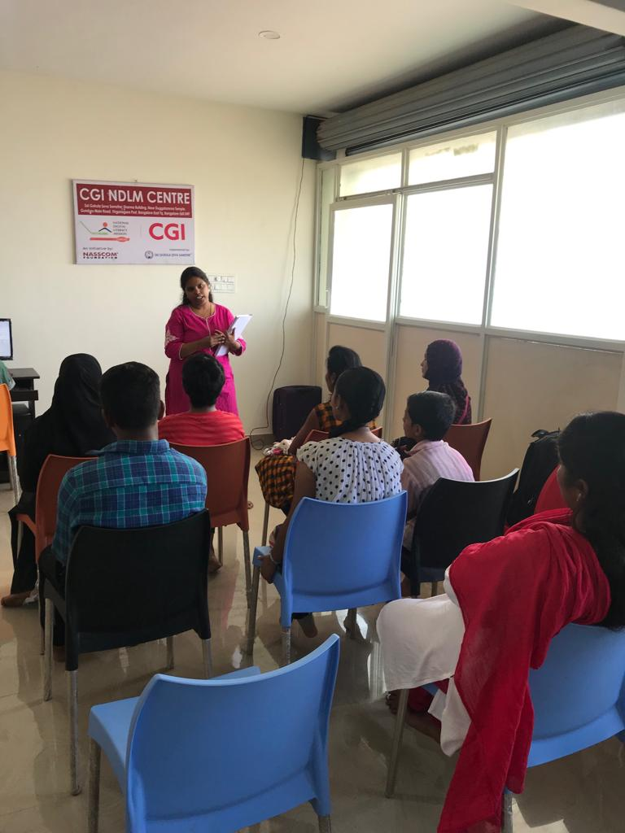
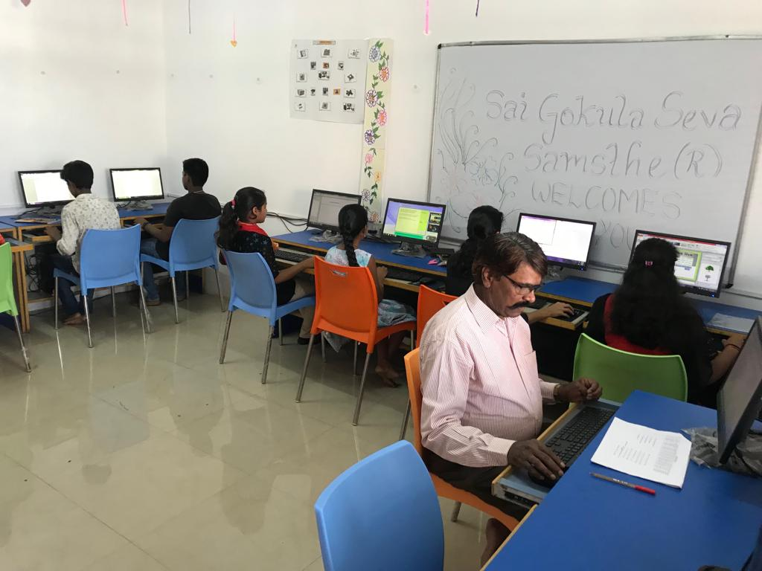
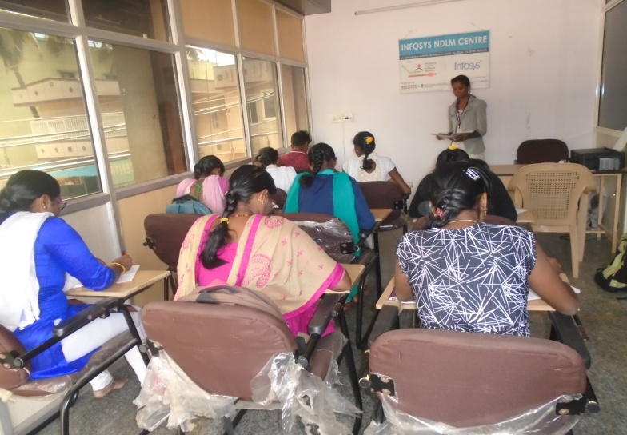
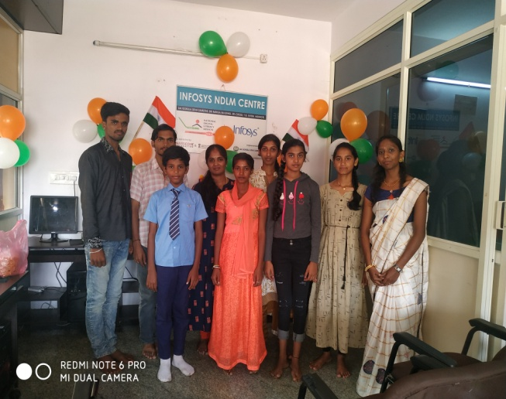
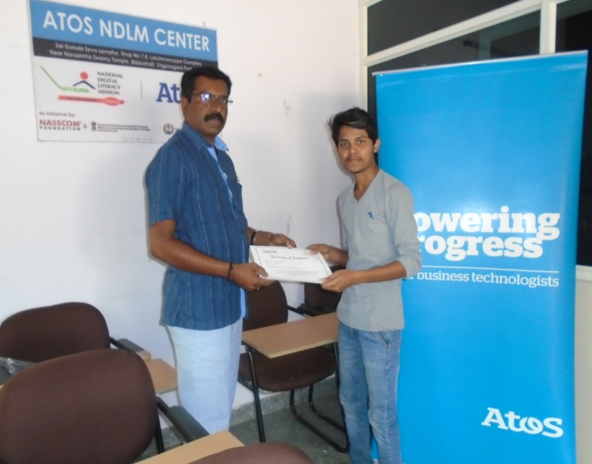

Slide 19
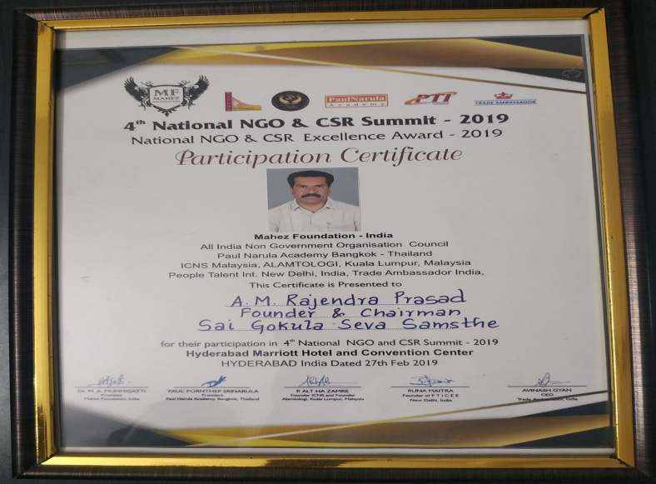
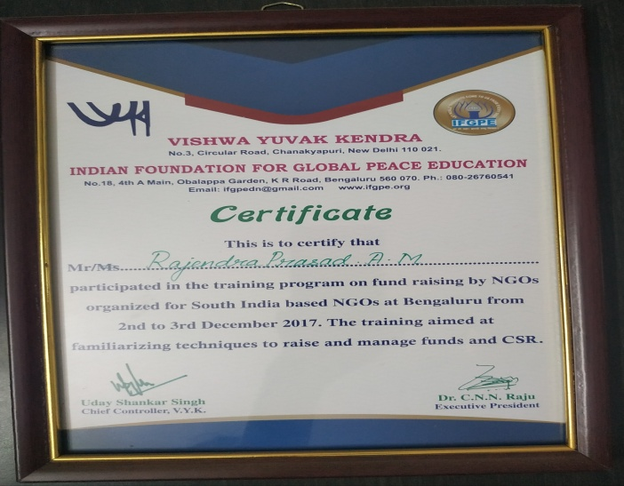
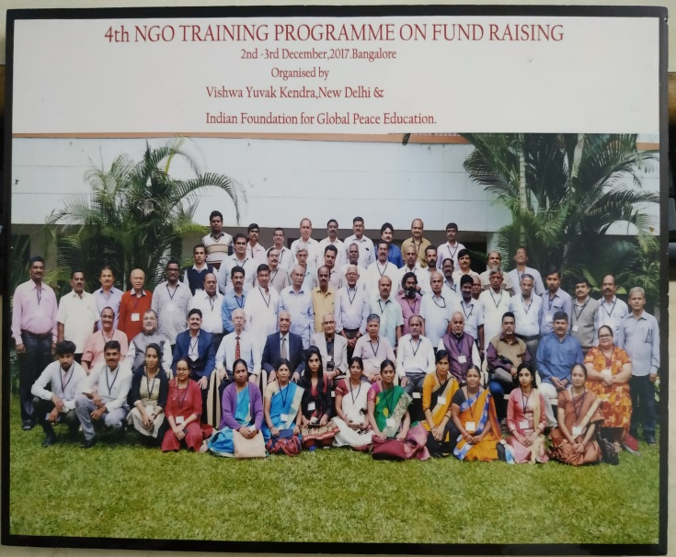
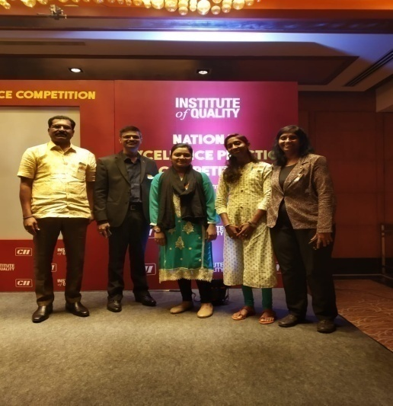
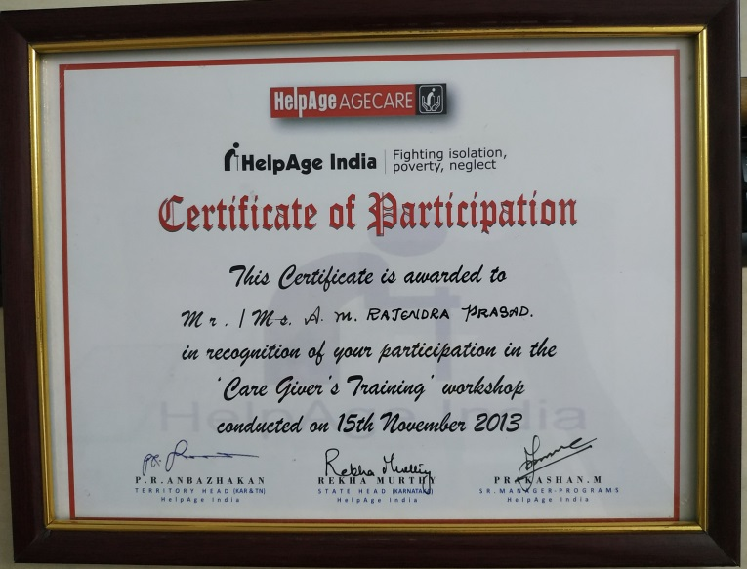

Slide 20
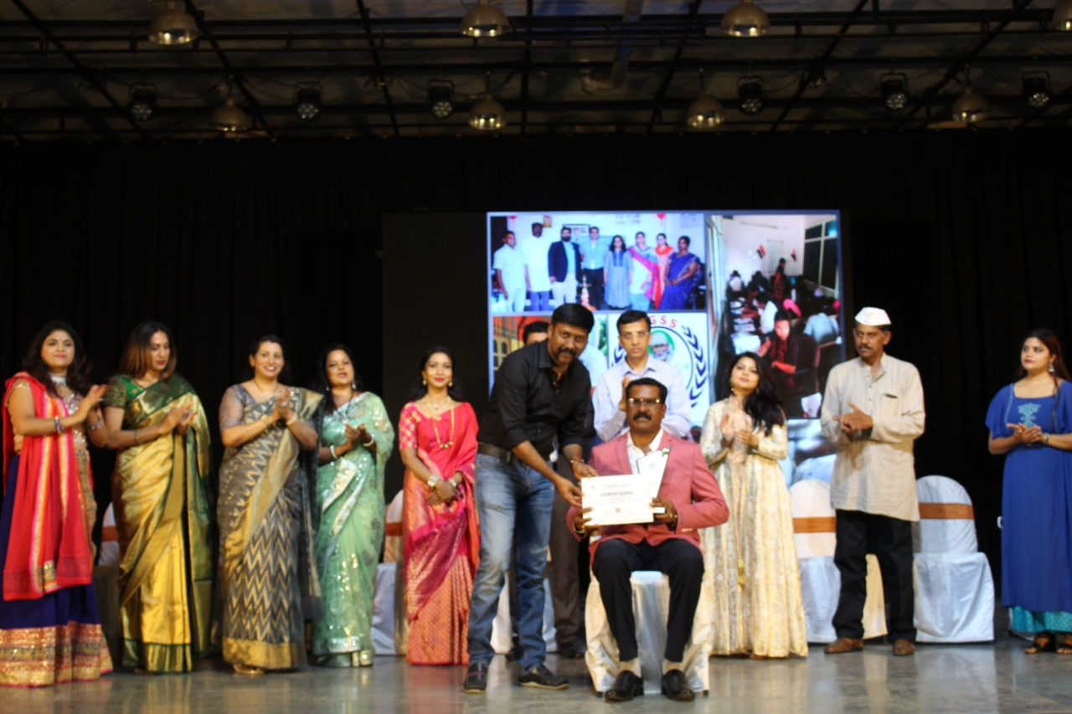
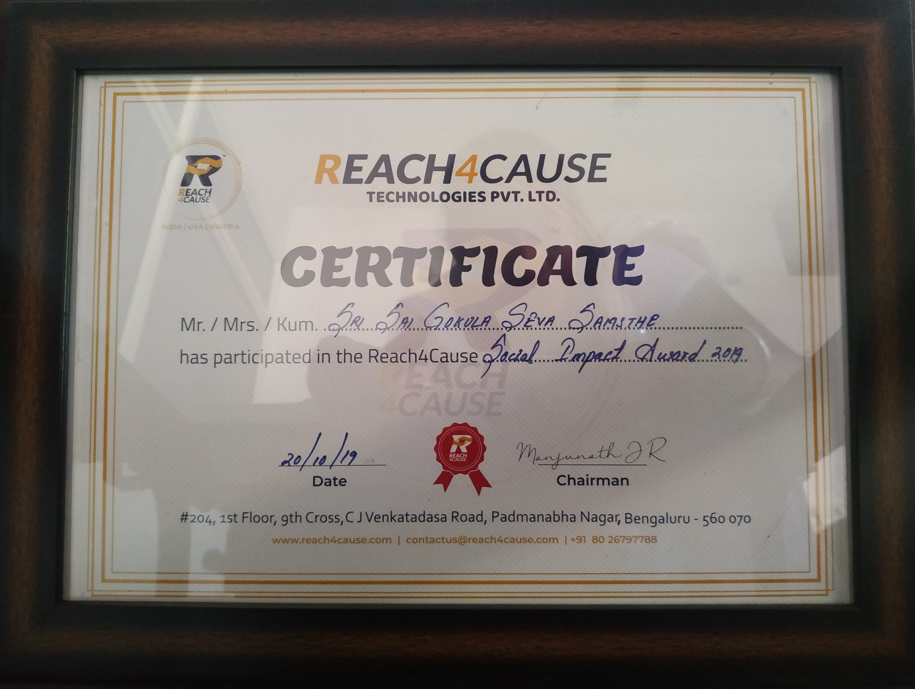

Slide 21
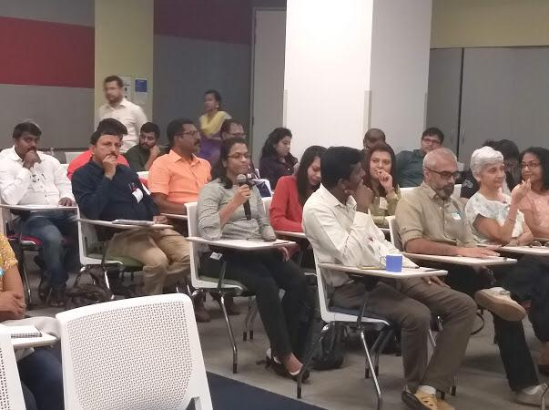
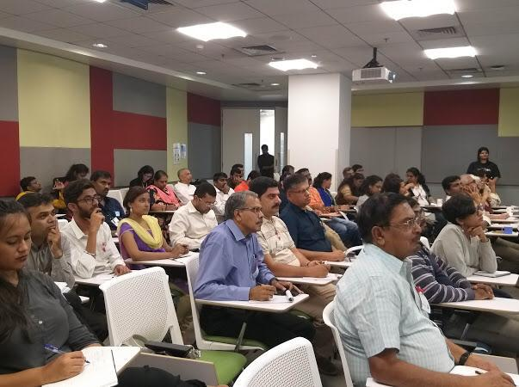
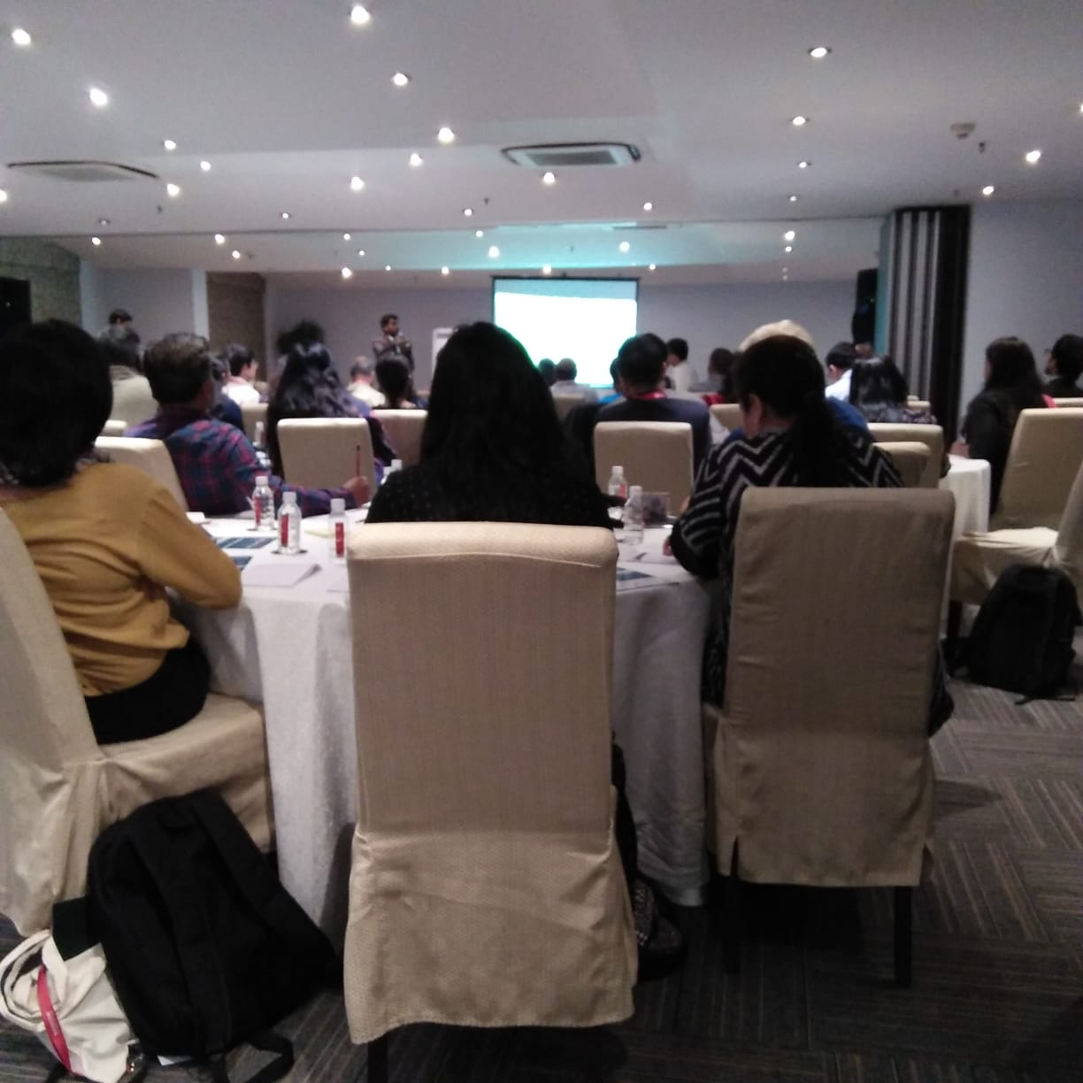
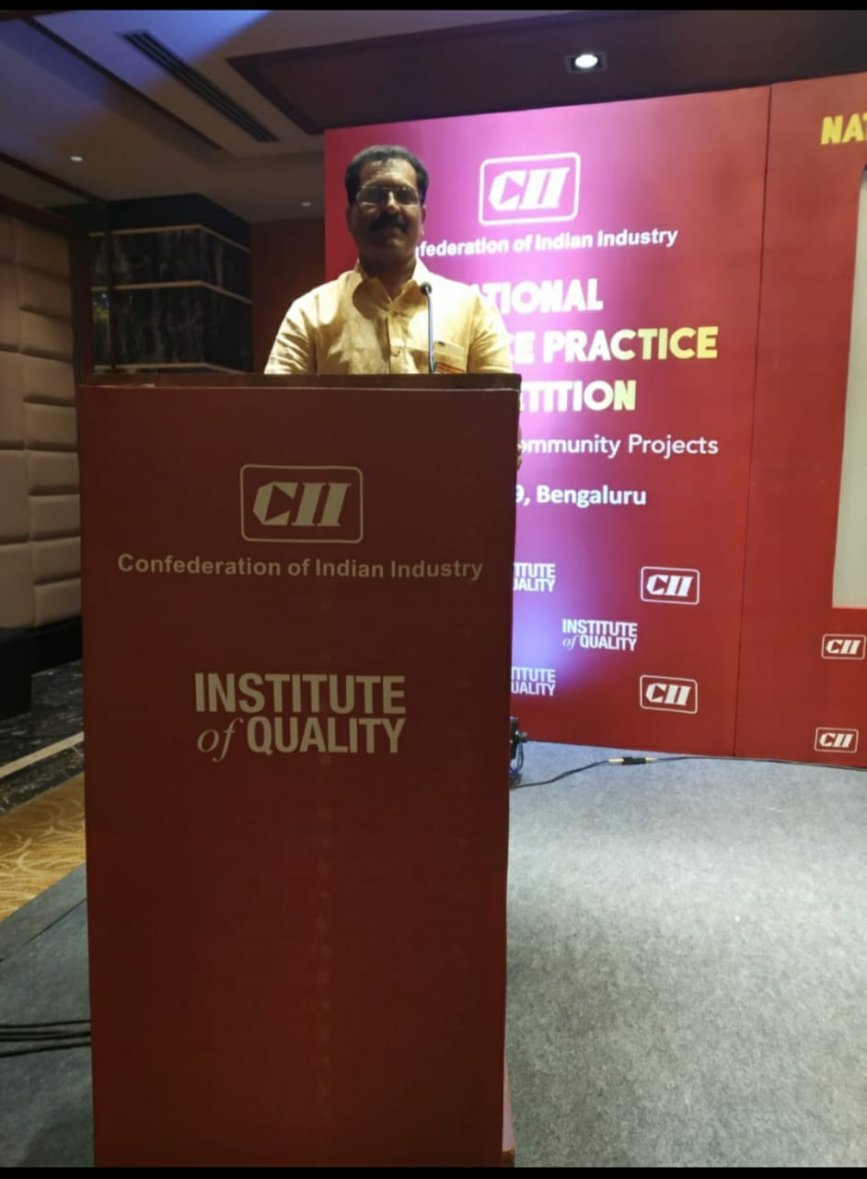
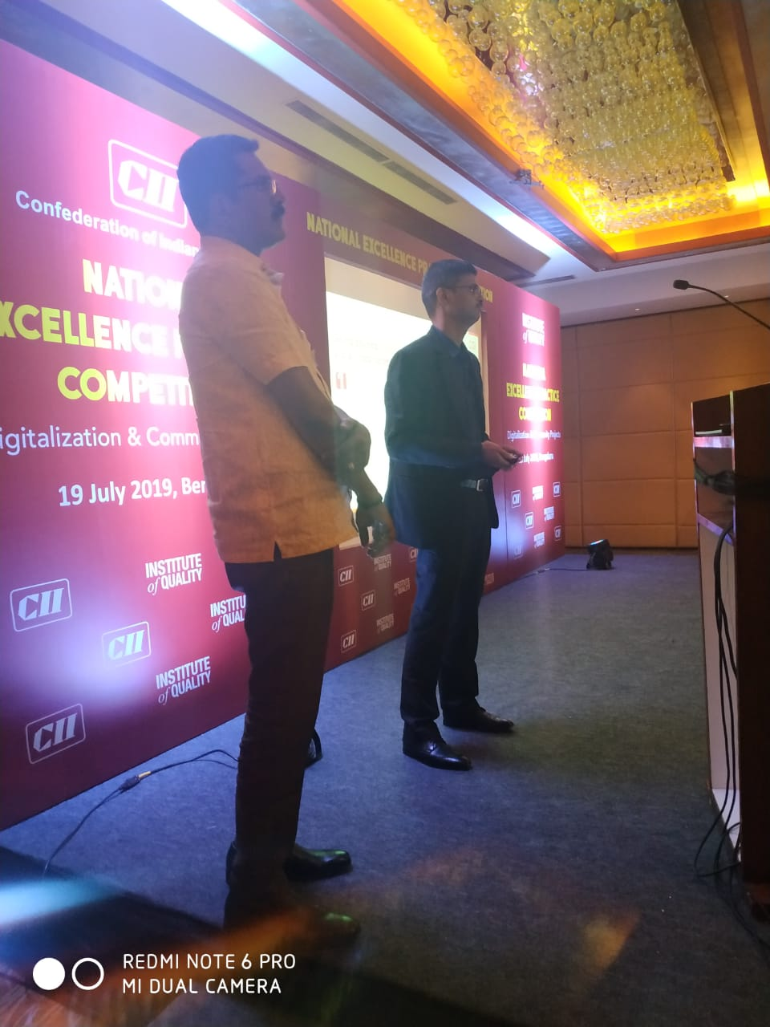

Slide 22
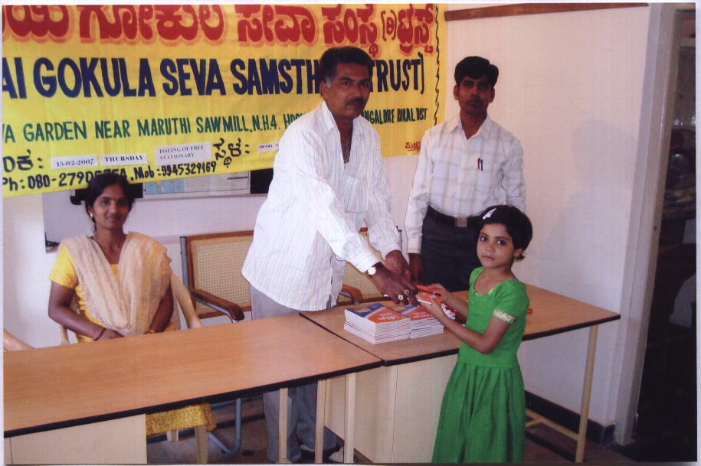
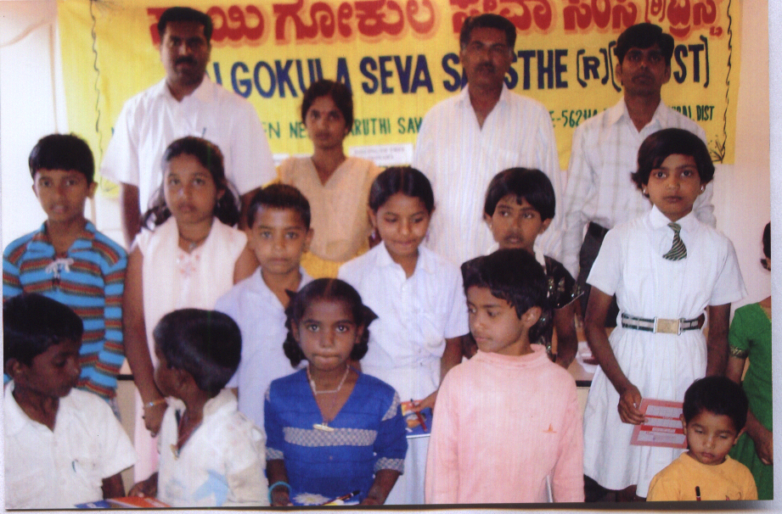
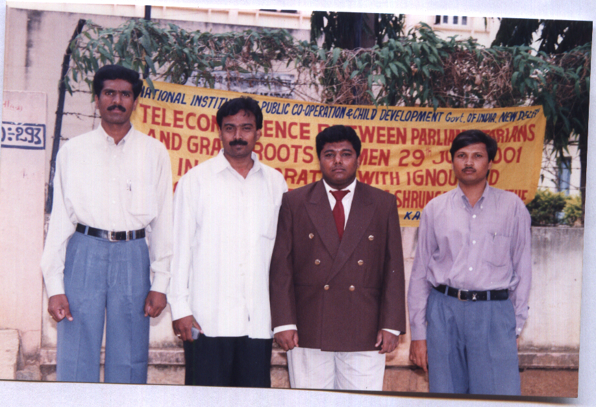
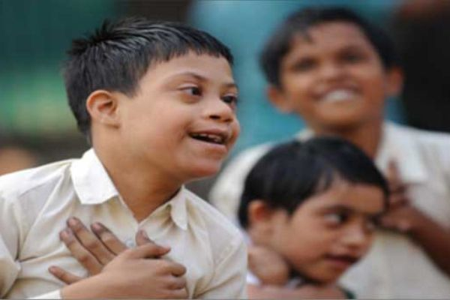
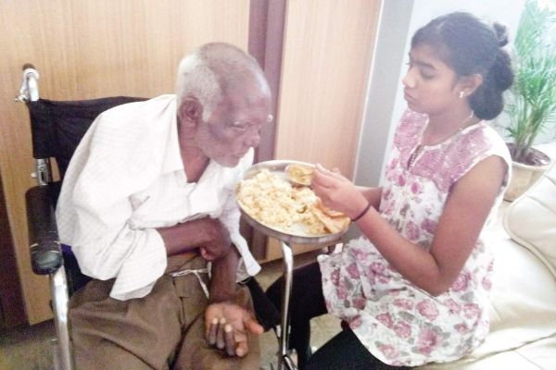
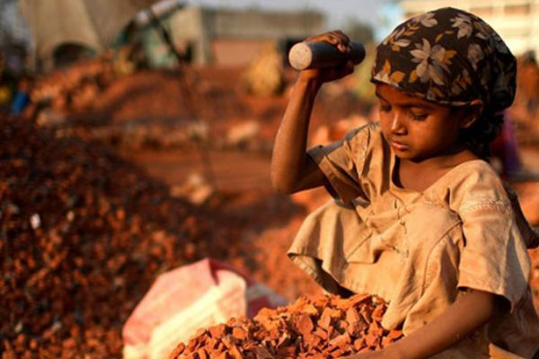
Achievements
Too many achievements to pen down – but a few to showcase here

